Slide 1

POLITICAL SENTIMENT ANALYSIS
Project Associates: Guide:
1. D. Sai Maneesha A.Radhika
2. M. Krishna Chaitanya Senior Asst.Professor
3. Ch. Bhargav sai Dept of CSE
4. Ch. Naga Lakshmi

Slide 2
Contents
Introduction
Objective
Abstract
Need of the project
Literature Review
System Analysis
System Design
Output Screens
Testing
Future Enhancements
Conclusion

Slide 3
Objective
The objective is to extract expressions of opinions from public and predict the support of political member for upcoming assembly elections 2019 by classifying them as positive, negative and neutral.

Slide 4
Abstract
The proliferation of social media in the recent past has provided end users a powerful platform to voice their opinions.
One such application is in the field of politics, where political entities need to understand public opinion and thus determine their campaigning strategy.
The popularity of a person can be predicted in politics also which will help the party to understand the sentiment and opinion of public about their party member which can help them in wining a election.
Sentiment analysis on social media data has been seen by many as an effective tool to monitor user preferences and inclination.

Slide 5
Need of the project
Every day, billions of people communicate on the online social network.
Twitter, with more than 200 million users all over the world.
Message posts can contain the sharing of some kinds of abusive or offensive contents which can emerge the threats like cyber bullying.
We intend to explore an analysis to these issues by using trusted system machine learning algorithms using python to find out the polls like abusing words about various political parties, politicians by considering various social media posts on them in twitter.

Slide 6
Literature Review
Fedrico Neri describes a sentiment analysis study performed on about 1000 Face book posts about new casts and comparing the sentiments of Rai in which two techniques of Sentiment Analysis
Supervised Machine Learning- It requires a training set of texts with manually assigned polarity values for the learn features (words) that correlates with the value.
Unsupervised Machine Learning- That uses a lexicon with words scored for polarity values such as neutral, positive or negative.

Slide 7
Literature Review
Yasufumi Takama in their paper proposed method by which a user profile is generated by using user’s TV watching behavior using sentiment analysis. The method generates positive and negative profile with bookmark format for each user based on iPEG and estimated rating of watching TV programme.
If user watches program for long time that means he/she is interested and if changes channel frequently that means he/she is not interested.

Slide 8
Existing System
The media plays a vital role in a democracy; informing the public about political issues and acting as a watchdog against abuses of power. During election campaigns the media provides information and analysis about the political party’s programmes, policies, candidates and performance.
DRAWBACK
Government influence, including overt and covert censorship, such as Sakshi TV is owned by Jagan Mohan Reddy along with NTV and TV5 in Andhra Pradesh supports him, Studio N is owned by Narne Srinivasa Rao, a businessman related to N.Chandrababu Naidu biases the media resulting in biased surveys.

Slide 9
Proposed System
The use of social media in politics including Twitter, Facebook and YouTube has dramatically changed the way campaigns are run and how people interact with their politicians.Twitter attracts a very peculiar subset of citizens, the role of the web in this regard is significantly stronger than that of the mass media.
ADVANTAGE
On average social media users are younger and better educated than non-users, and they are more liberal and pay more attention to politics. So the analysis will be transparent.

Slide 10
Modules
End User Module: User can open the web application, enters the keyword related to political party or politicians, and checks the support of a political party or a political leader.

Slide 11
H/w and S/wRequirements
HARDWARE REQUIREMENTS
Processor : Intel Core I3
RAM : 4GB (Minimum)
Hard Disk : 1TB
SOFTWARE REQUIREMENTS
Operating System : Windows7/8/10
Application Server : FLASK in Python
Front End : HTML, CSS
Back End :Machine Learning with Python
Tools : Anaconda spyder, Anaconda Prompt, Brackets

Slide 12
Functional Requirements
Functional requirements are the functions or features that must be included in any system to satisfy the business needs and be acceptable to the users. Based on this, the functional requirements that the system must require are as follows:
System should be able to process new tweets stored in database after retrieval.
System should be able to analyze data and classify each tweet polarity.

Slide 13
Non-Functional Requirements
The major non-functional requirements of the system are as follows:
Usability
Reliability
Performance
Supportability

Slide 14
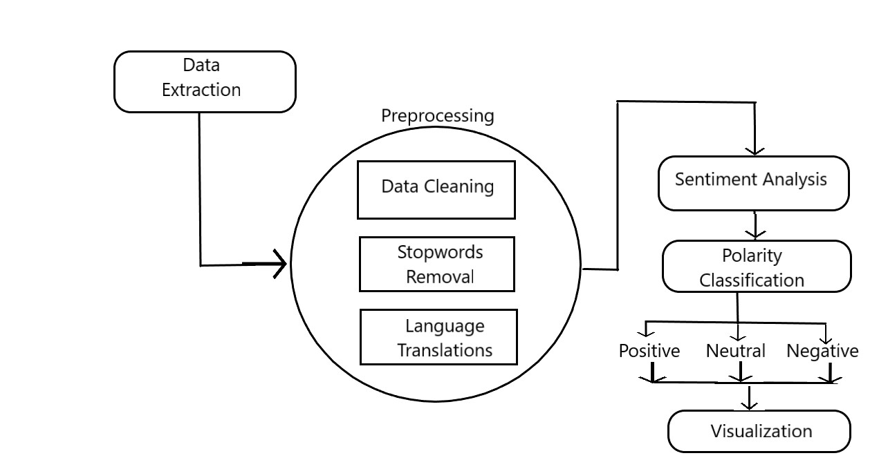
System Architecture

Slide 15
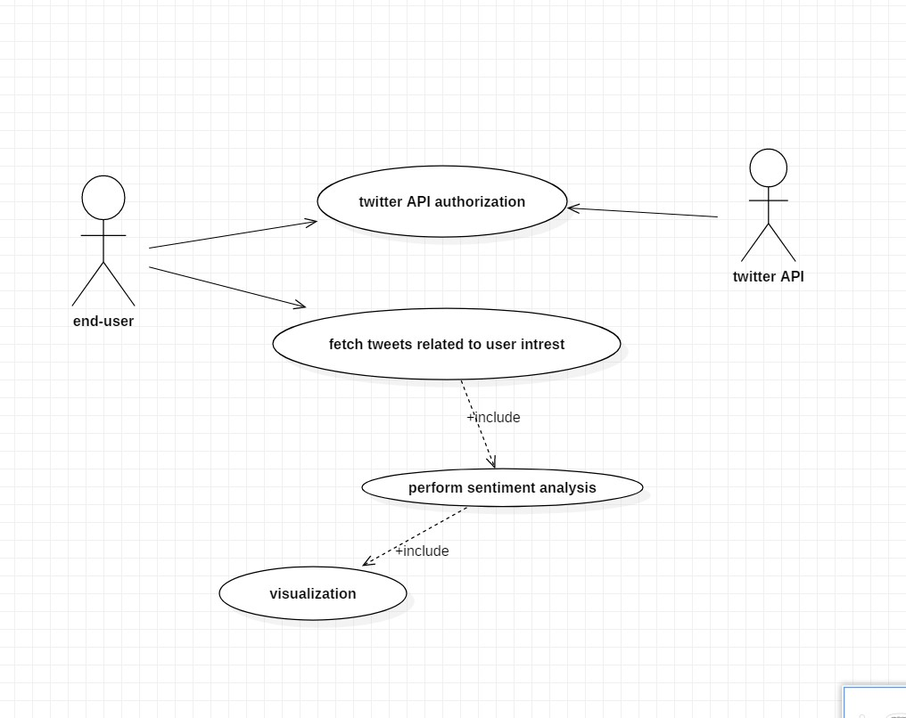
UML Diagrams
Use case:

Slide 16
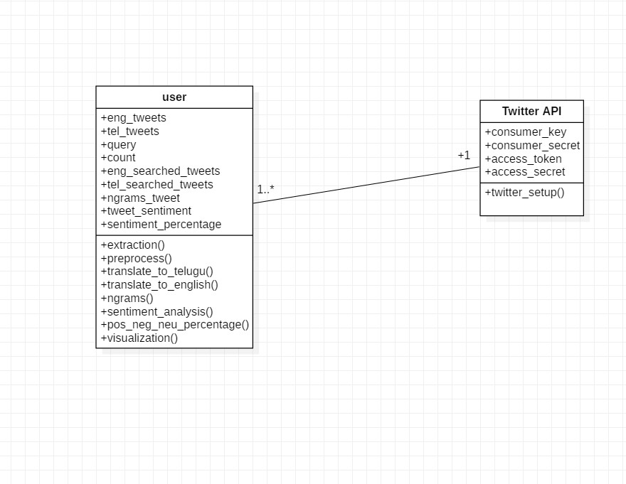
Class diagram:

Slide 17
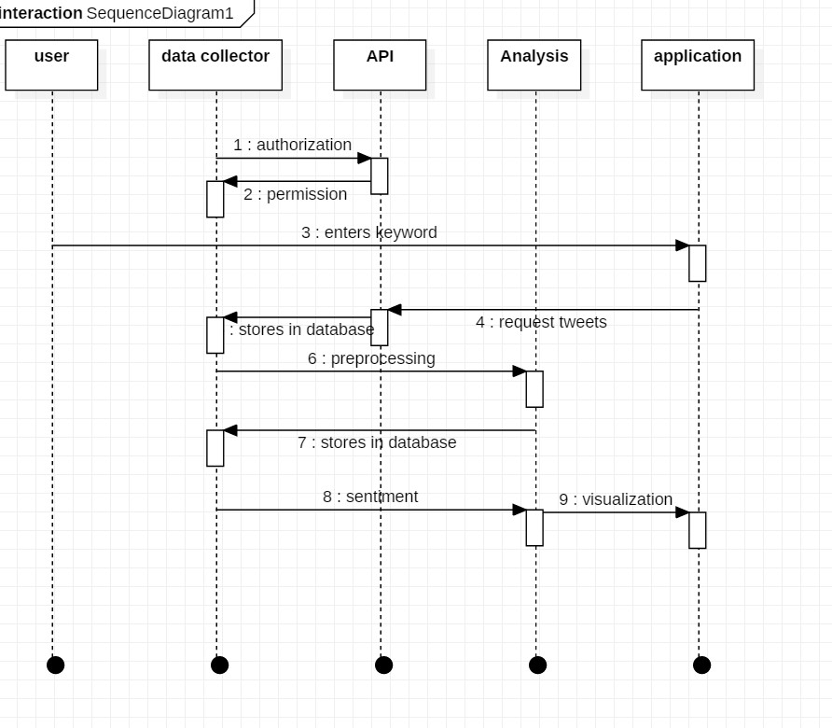
Sequence diagram:

Slide 18
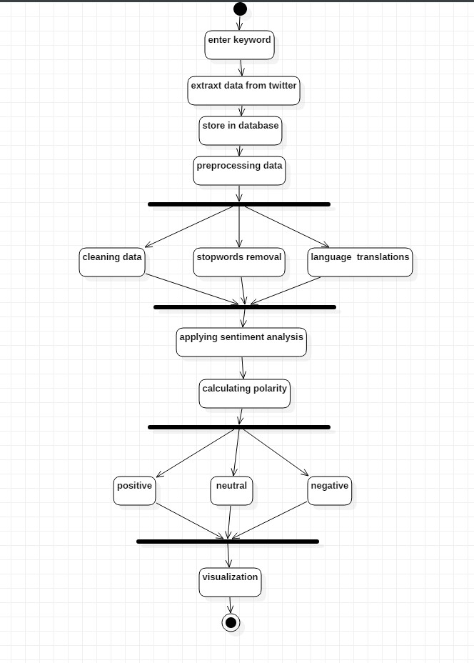
Activity diagram:

Slide 19
Technology Description
Machine learning (ML) is the scientific study of algorithms and statistical models that computer systems use to effectively perform a specific task without using explicit instructions, relying on patterns and inference instead. It is seen as a subset of artificial intelligence.
Data mining is a field of study within machine learning, and focuses on exploratory data analysis through unsupervised learning. In its application across business problems, machine learning is also referred to as predictive analytics.

Slide 20
Applications of Machine learning
Machine learning has a wide range of applications one of them is the sentiment analysis. Opinion mining (sometimes known as sentiment analysis or emotion AI) refers to the use of natural language processing, text analysis, computational linguistics, and biometrics to systematically identify, extract, quantify, and study affective states and subjective information.
Sentiment analysis is widely applied to voice of the customer materials such as reviews and survey responses, online and social media, and healthcare materials for applications that range from marketing to customer service to clinical medicine.

Slide 21
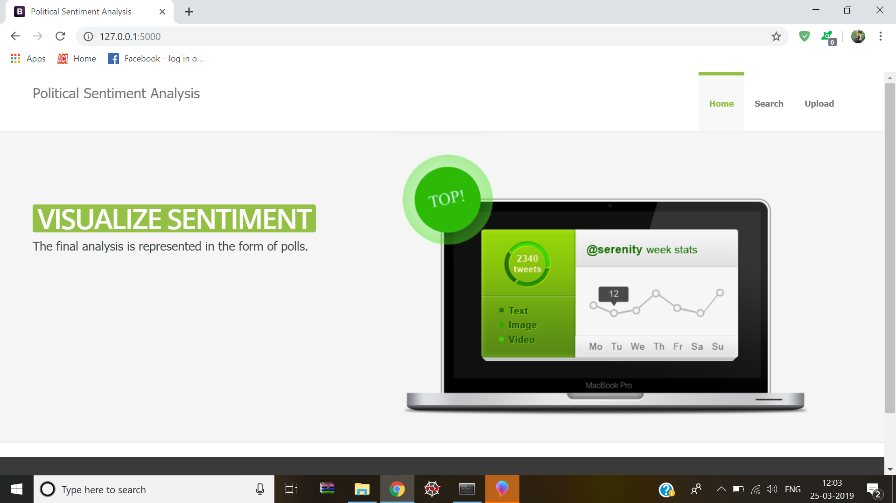
Output Screens

Slide 22
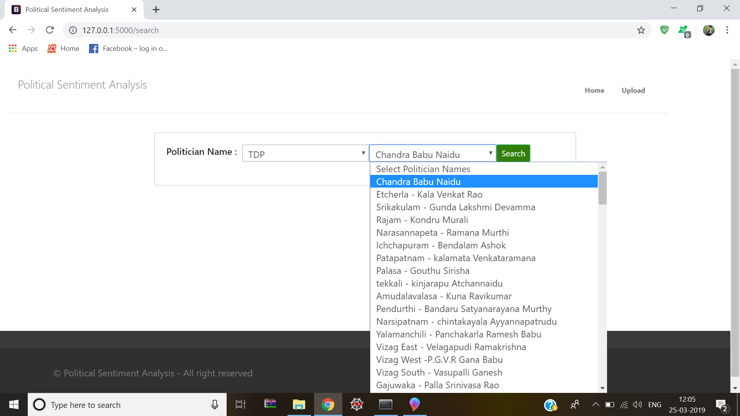

Slide 23
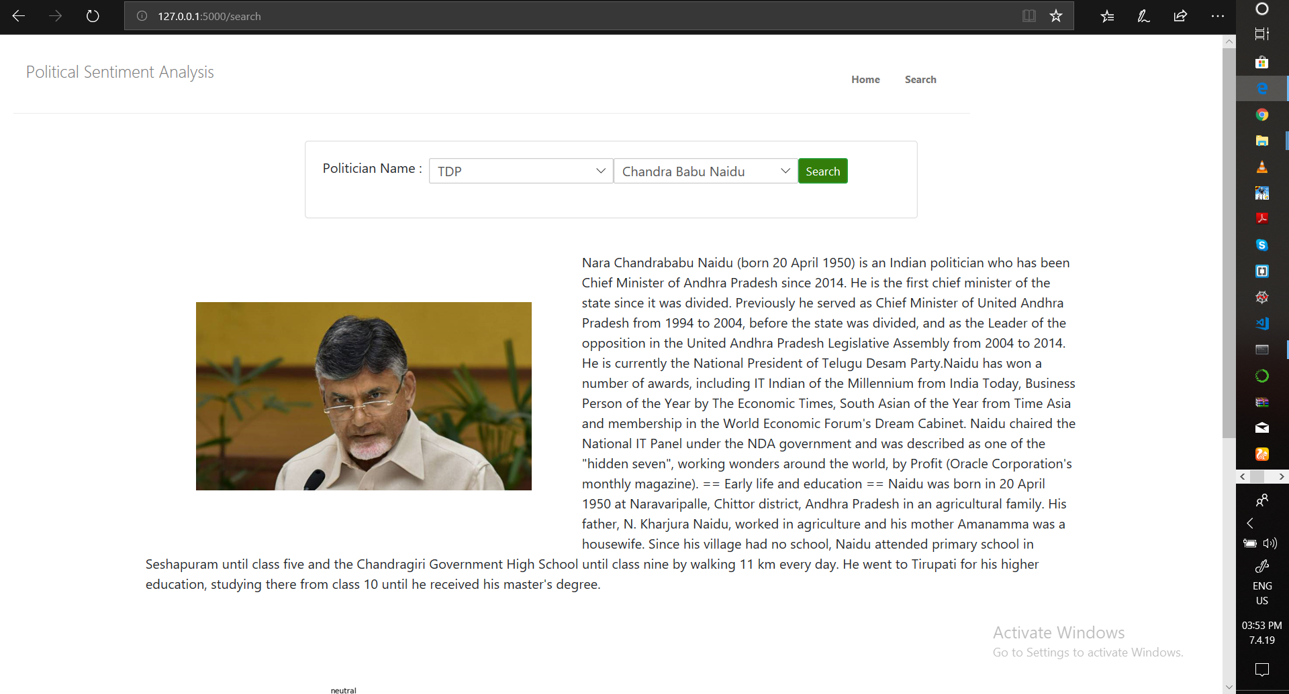

Slide 24
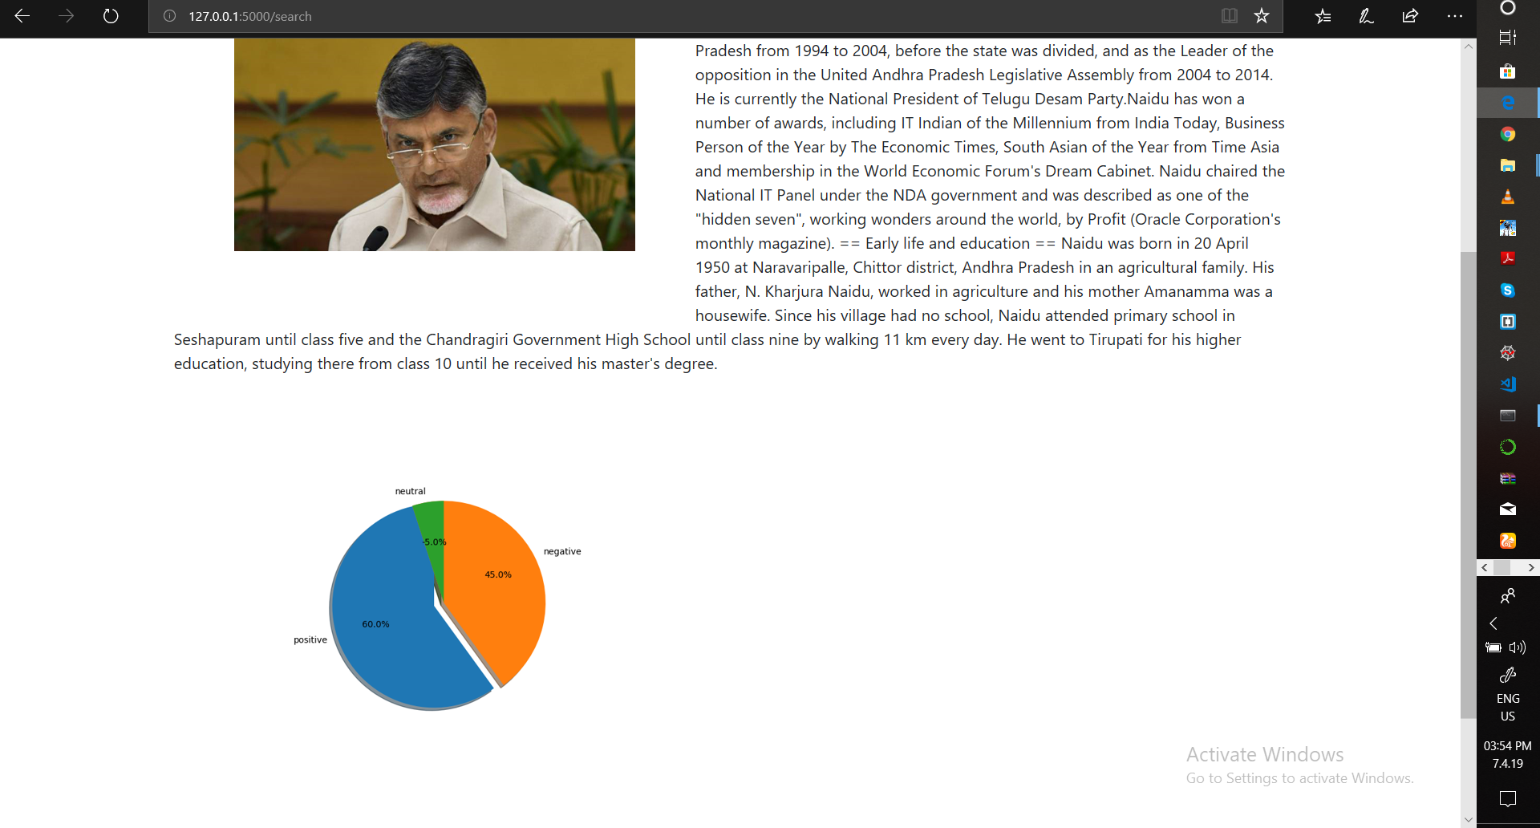

Slide 25
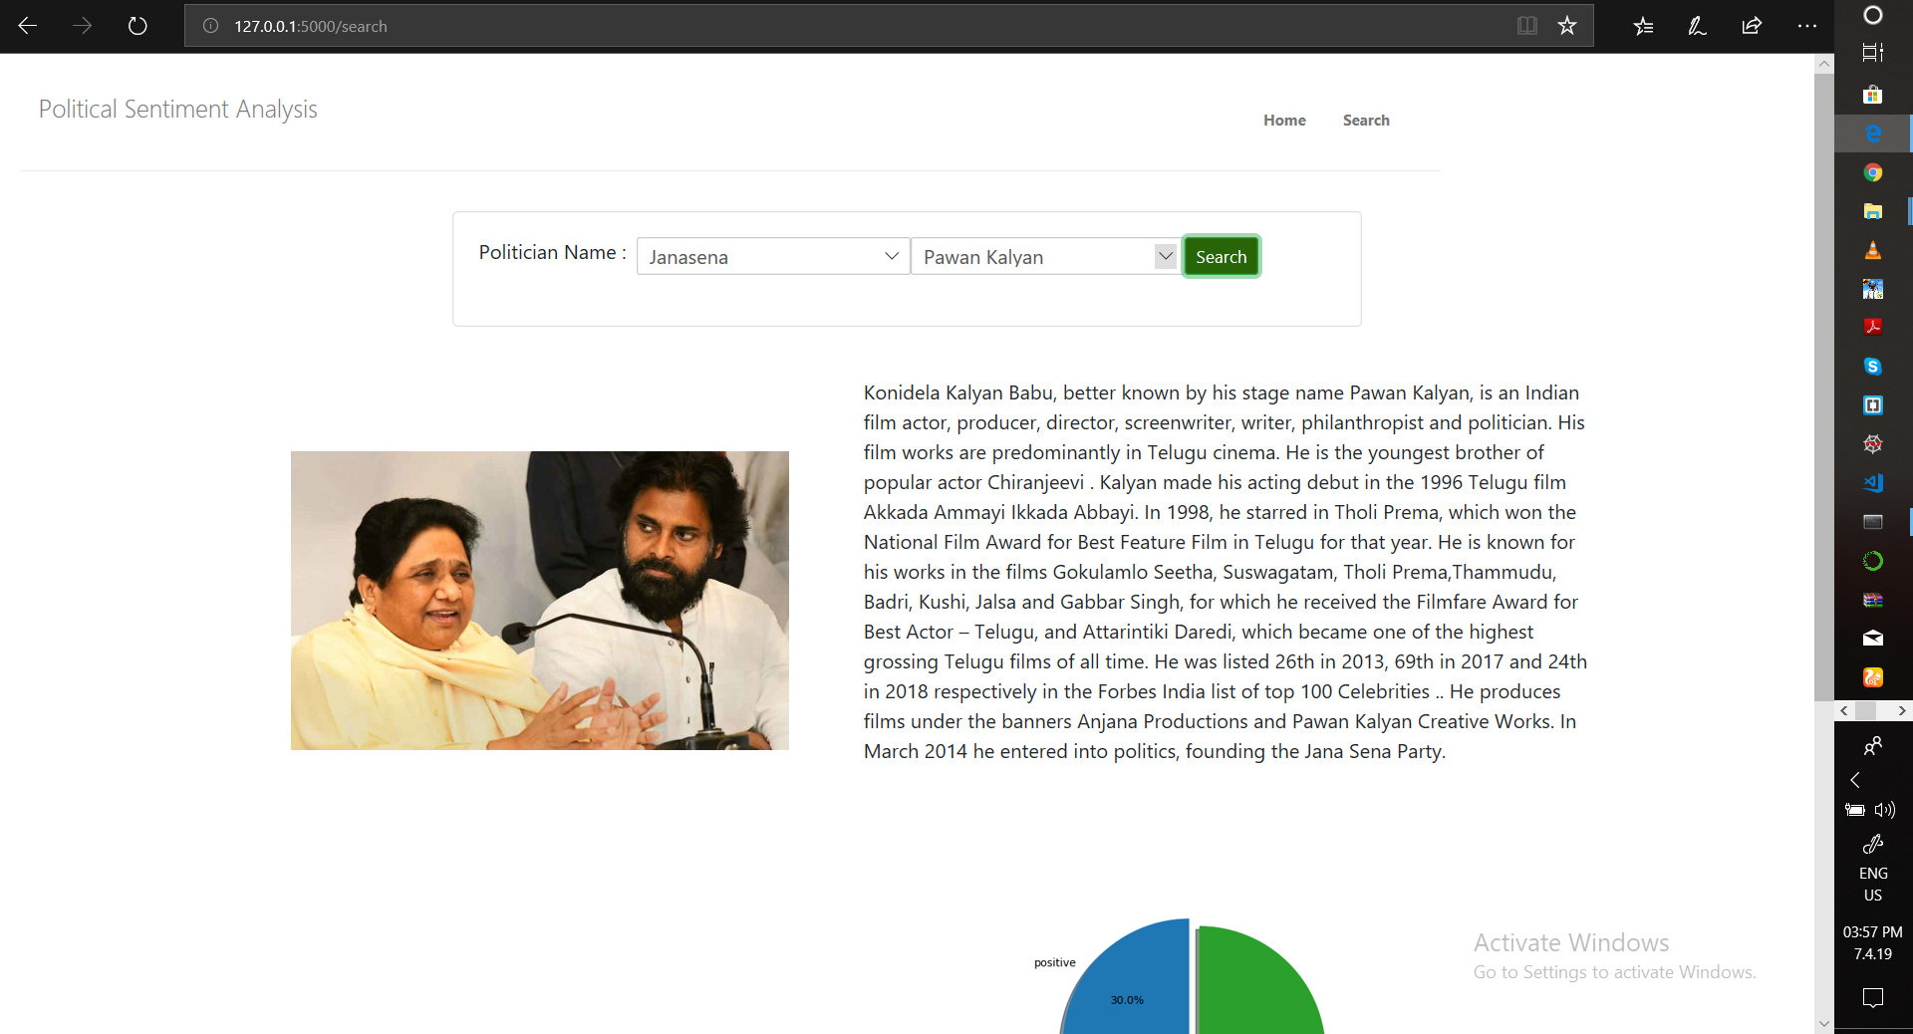

Slide 26
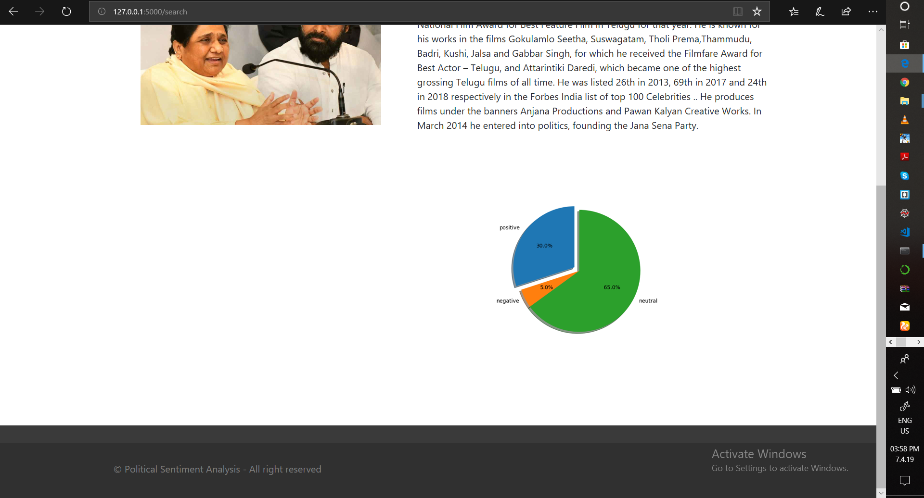

Slide 27
Test Cases
Test Case id | Test case description | Input | Expected output | Actual output
Tc1 | Number of tweets | Count=30 | 30 tweets | 30 tweets
Tc2 | Sentiment for similar tweets | KCR is the CM of Telangana, telangana’s CM, is KCR | Positive, positive | Positive, positive
Tc4 | Downloaded image should be real | Chandra Babu Naidu | (Image from Chandra Babu Naidu) | (image of cbn)
Tc5 | Importing and using a python file in another python file | Preprocessing.py in run.py | Successful execution | Successful execution

Slide 28
Conclusion
This project is developed on the basis of support of public for a particular political party or politician.
Now a days the rapid growth of social media users led to the public to raise their voice on various issues.
Twitter being professional over the decades with educated users the tweets will be more practical.
This project is using the tweets along with regional language tweets.
The extracted tweets are preprocessed. Sentiment is applied on the preprocessed set.
Finally, parsed tweets are returned with their polarity values.
Then, we can do various type of statistical analysis on the tweets.
For example, in above project, we tried to find the percentage of positive, negative and neutral tweets about a query.
From this Polarity Percentage we represented the support in pie-chart. By looking into the pie-chart an end user can easily know the support.

Slide 29
Future Enhancements
More efficient analysis can be done from other social media like Facebook, instagram other than twitter.
One more enhancement that can be done for this project is we can analyze the expected way of ruling the government by ruling party in past five years.

Slide 30
Thank You

